Slide 1
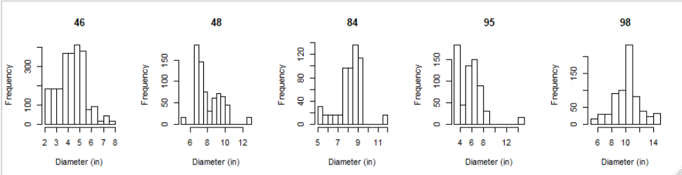
Slash pine with site index

Slide 2
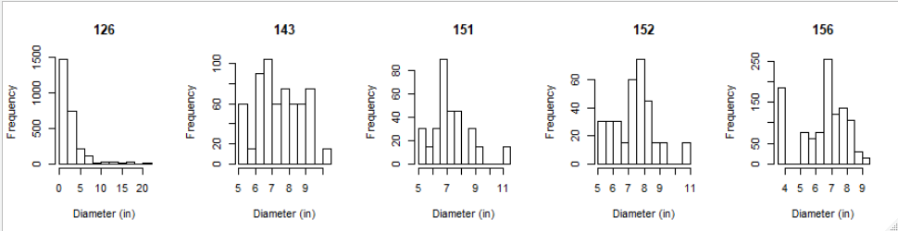
Slash pine with site index

Slide 3
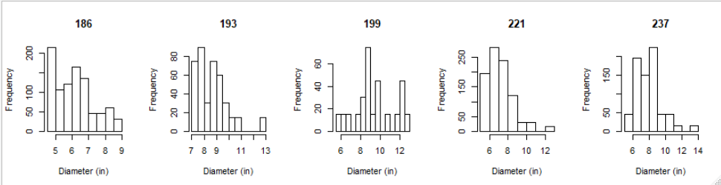
Slash pine with site index

Slide 4
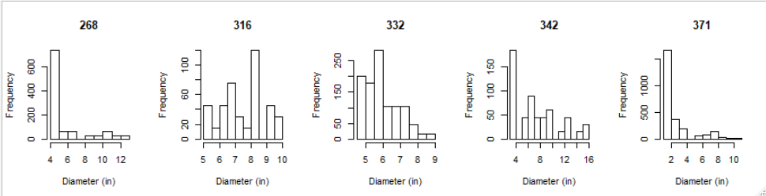
Slash pine with site index

Slide 5
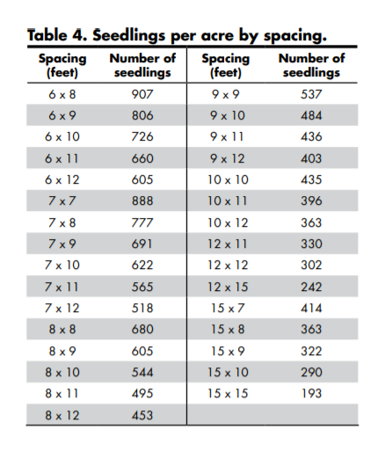
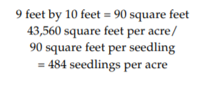
Historically 600-700tpa were used, but now 450-550tpa is more common (~1112-1359tph)
2.47acres in one hectare
Competition zone=6.4m or 21ft
Tree BA = .005454 x DBH(in)² (expressed as square feet per acre)
For m2/acre: (pi * (DBH)^2)/40,000

